Slide 1
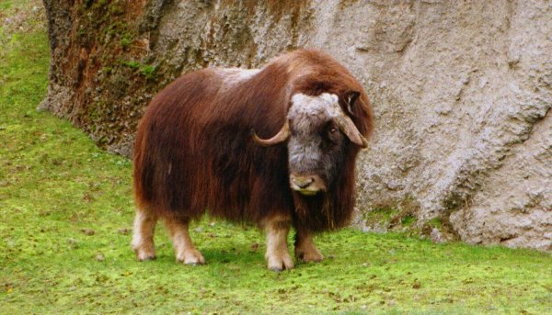
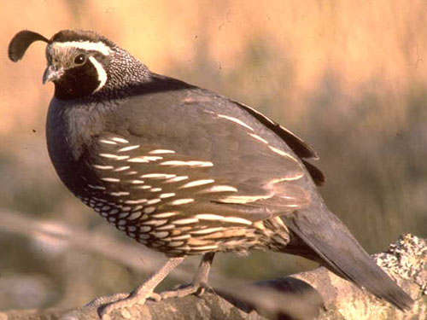
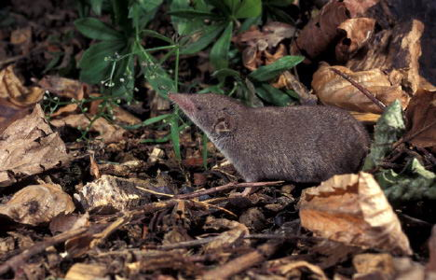
Lecture 2:
Variation

Slide 2
Exponential growth
N_{t+1} = R N_{t}
Assumption: R is constant
No environmental variability

Slide 3
Arithmetic vs. Geometric mean

Slide 4
Arithmetic vs. Geometric mean
36
36
9
6
4
6

Slide 5
Arithmetic vs. Geometric mean
My BMW stocks gained 4.5% in 2017, 3.5% in 2018 and 2.3% in 2019
Year 2016 | 100 euro
Year 2017
Year 2018
Year 2019
1.023
1.035
1.045

Slide 6
Variability in Muskox growth rates
1.16*1.14*0.94*1.25*1.1*1.17*1.11*1.16*1.09*1.14*1.27*1.14*1.24*1.14*1.2*1.15*1.15
What is the mean annual growth rate?
Arithmetic vs. Geometric mean?

Slide 7
Variability in Muskox growth rates
Growth rates varied substantially around the geometric mean growth rate 1.148
1.16*1.14*0.94*1.25*1.1*1.17*1.11*1.16*1.09*1.14*1.27*1.14*1.24*1.14*1.2*1.15*1.15
Questions from last lecture:
What is the average growth rate?
Predicted population size?
We can also ask:

Slide 8
Stochastic vs. deterministic models
Stochasticity = unpredictable variation
Deterministic models-
Stochastic models-
What is the probability that the Muskox population will decline below 10 individuals at least once within the next 100 years?
Critical population size-
Risk assessment-

Slide 9
There are 31 muskoxen. How likely is it that there would be less than 31 muskoxen 5 years in the future?
What is the probability that the population will increase by >30% rather than the average 14.8% in 5 years?

Slide 10
Environmental Variation

Slide 11
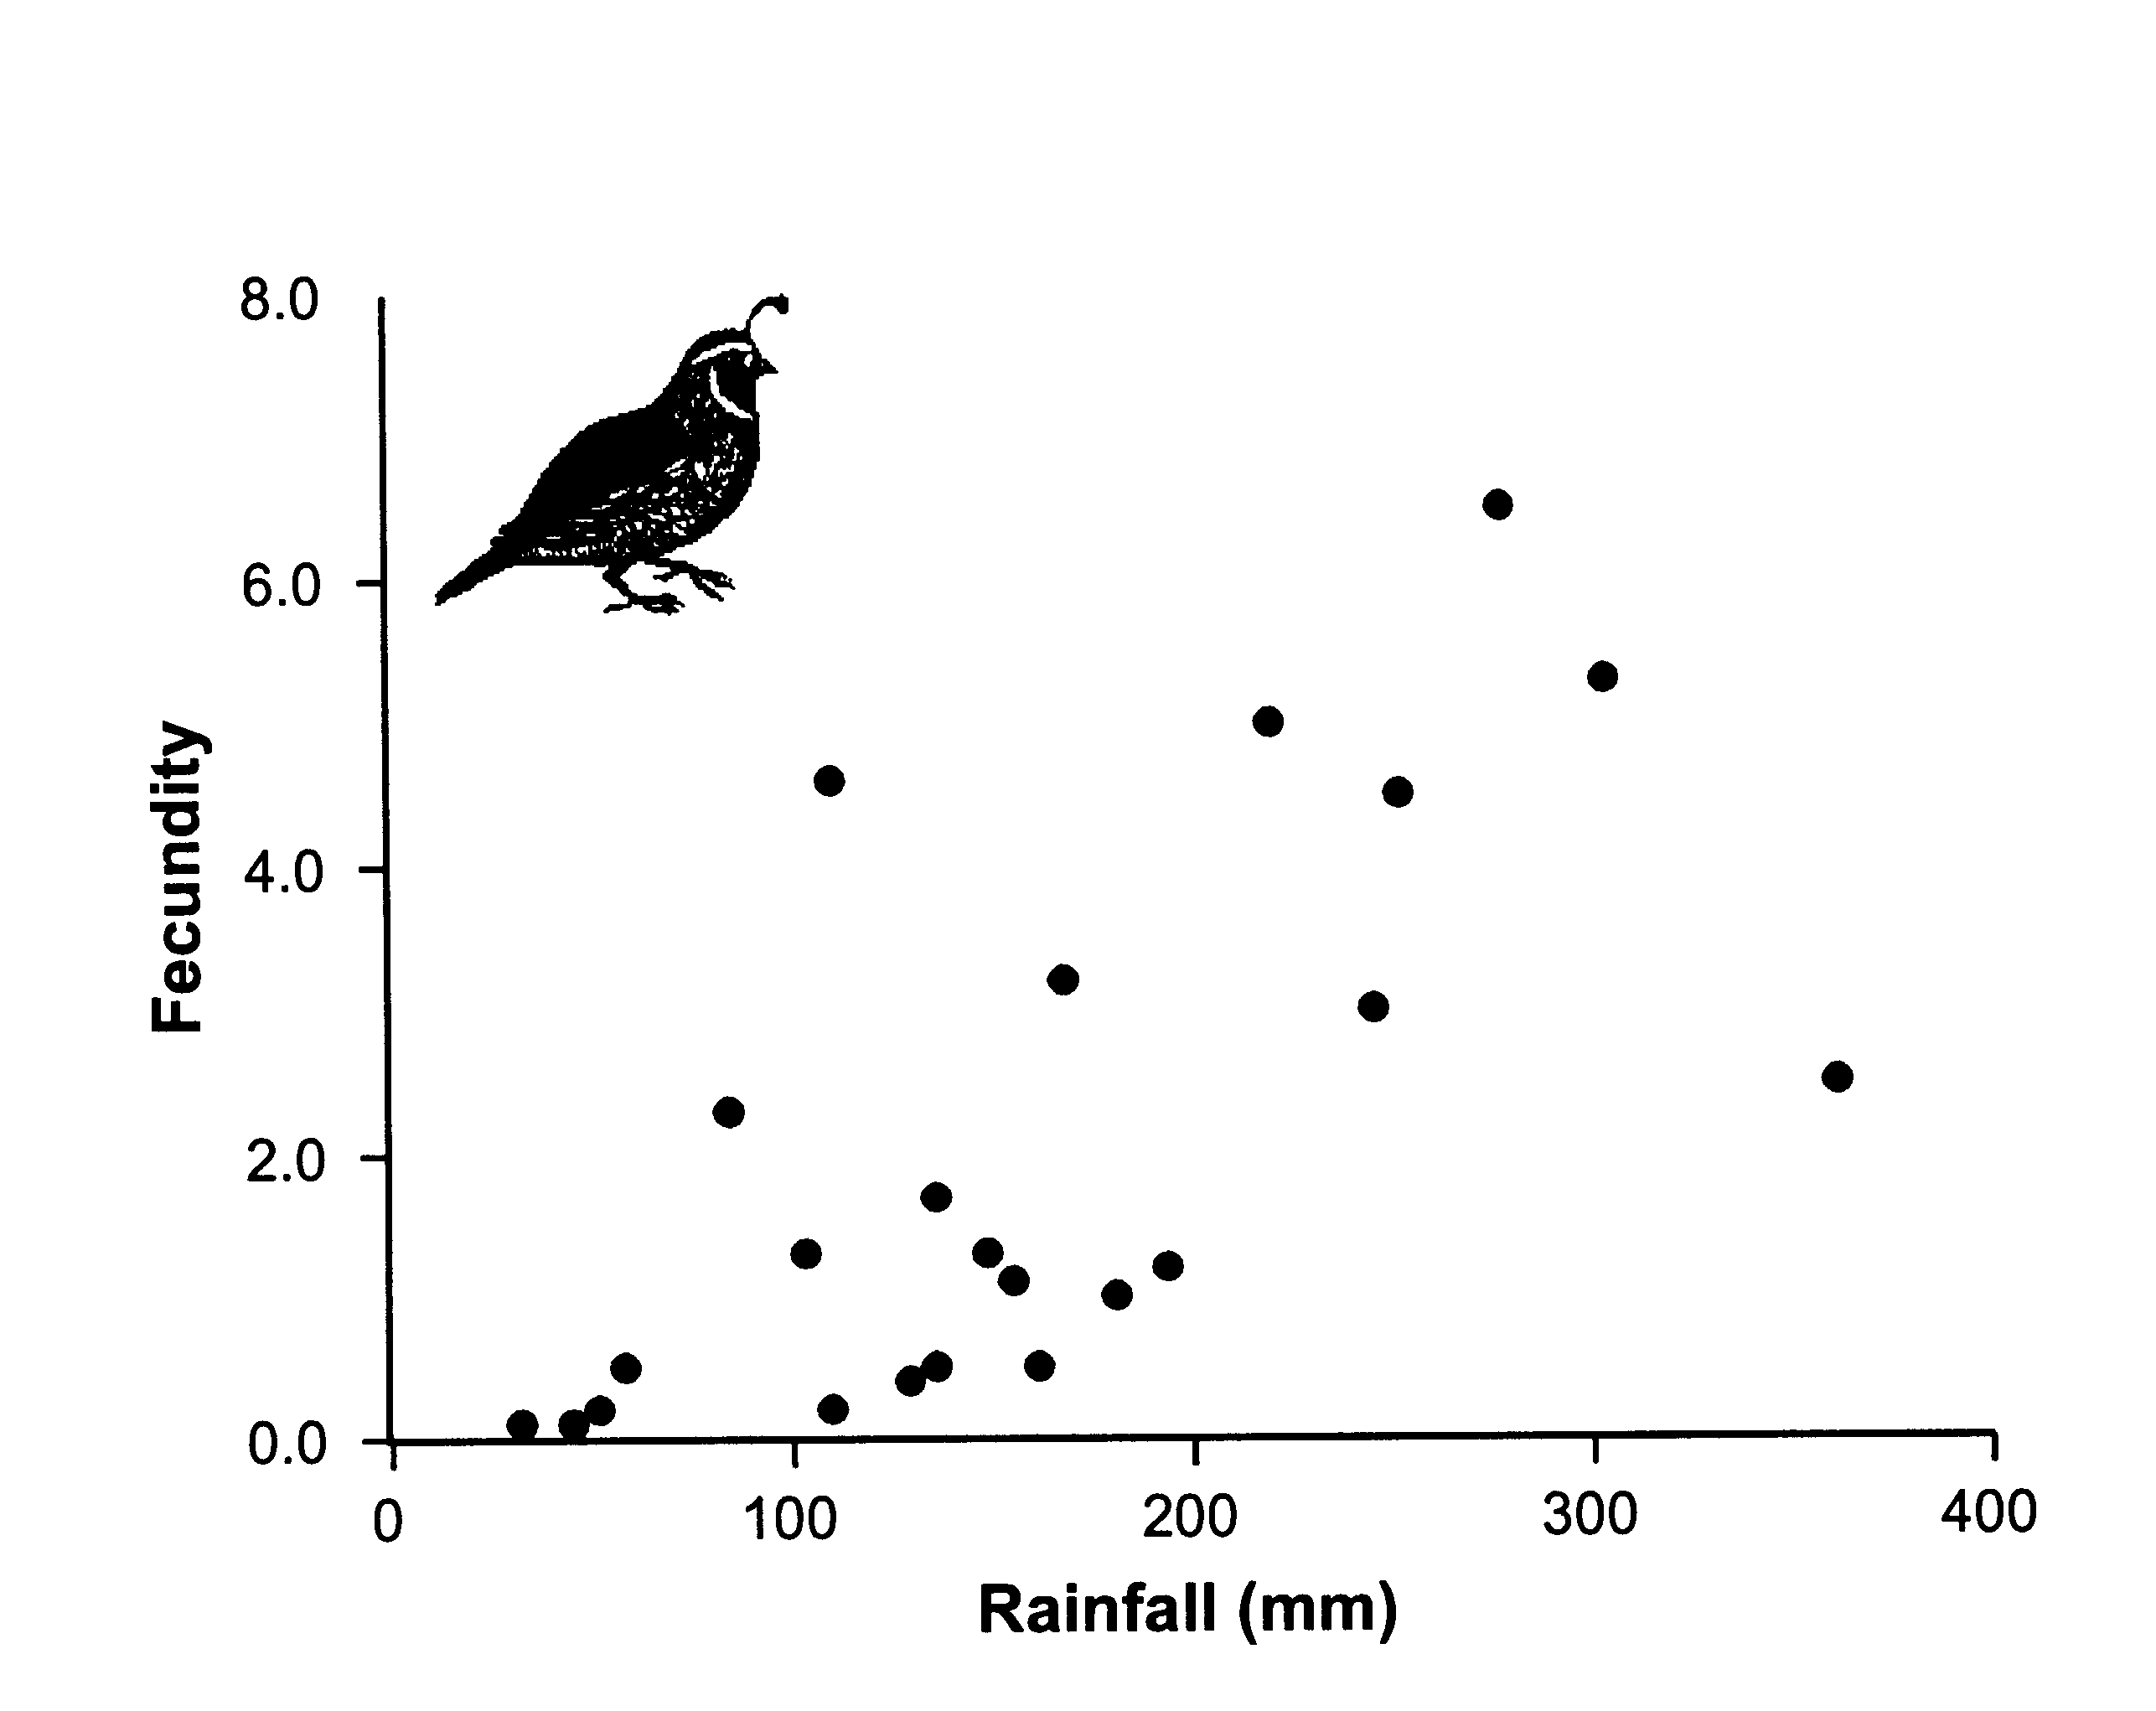
California Quail

Slide 12
Predicting population size in the face of environmental variation
Ideally, you would know:
Which environmental factor is important.
How that environmental factor affects birth and death rates.
What the value of that environmental factor will be in the future.

Slide 13
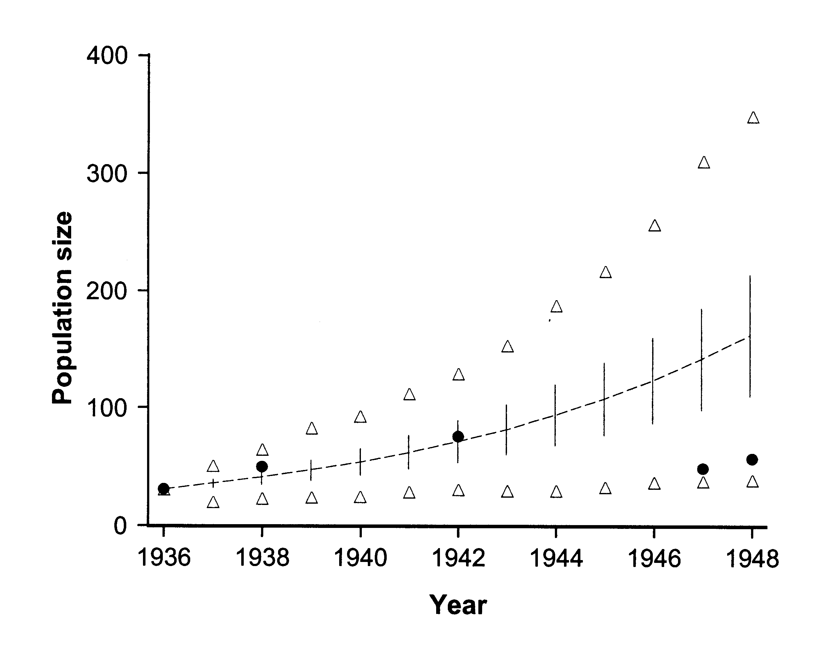
Population size of Muskox

Slide 14
Measurement error
All field measurements involve error
Try to quantify biases and minimize measurement error

Slide 15
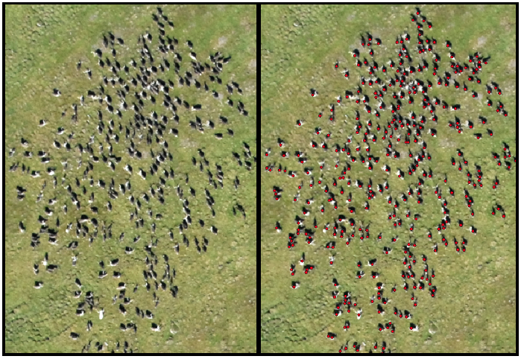
Aerial counts

Slide 16
Muskox sampling
Aerial census- used to estimate population size- calculate model parameters
More accurate estimates were made based on ground sampling from 1965-1968.
Year | Ground count | Aerial count (estimate) | Bias (count/estimate)
1965 | 532 | 514 | 1.035
1966 | 610 | 569 | 1.072
1967 | 700 | 651 | 1.075
1968 | 750 | 714 | 1.050

